Slide 1
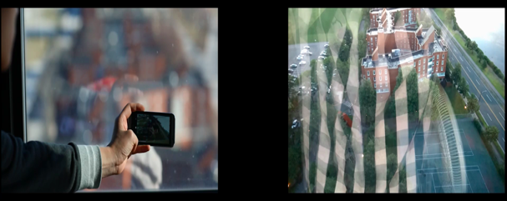
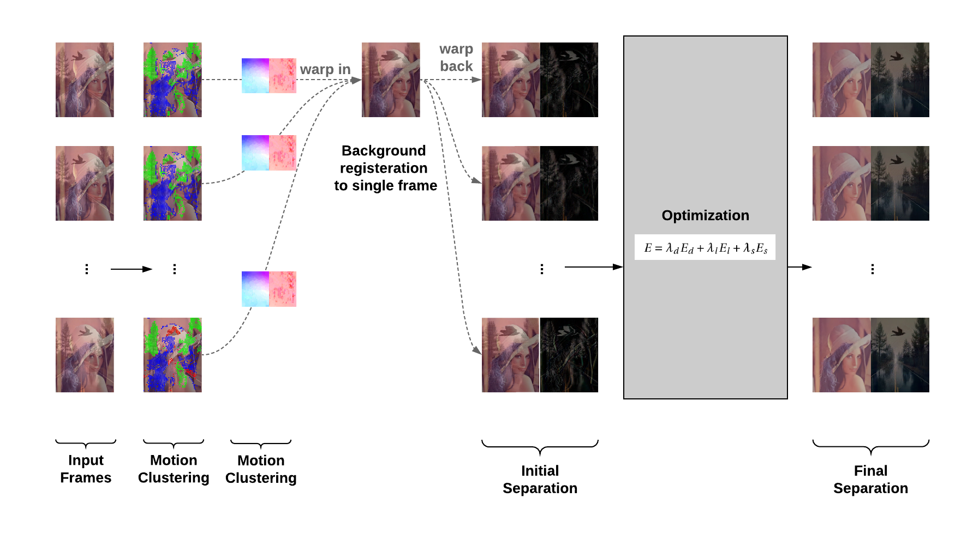
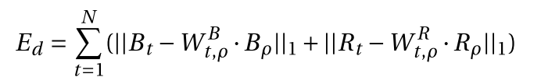
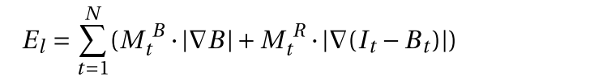
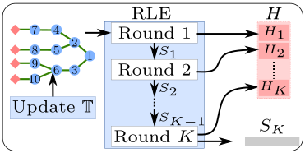
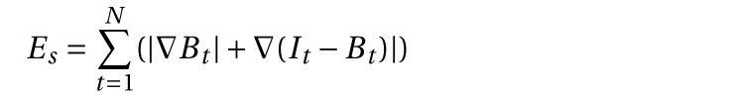


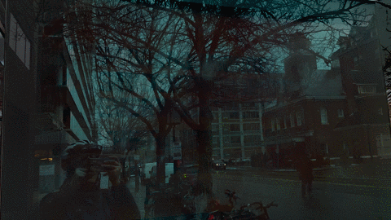

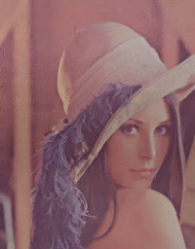
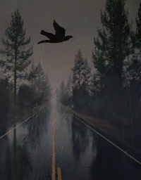
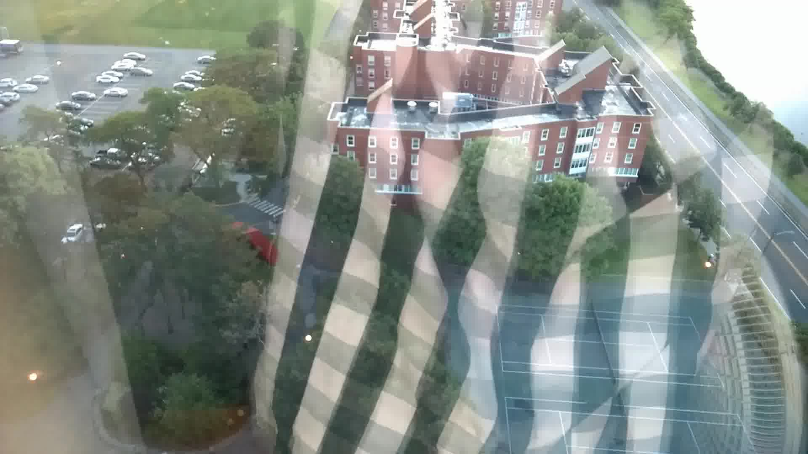

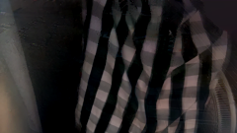
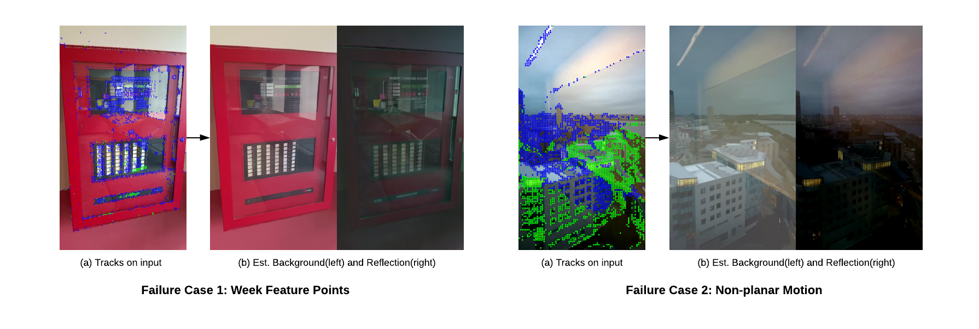
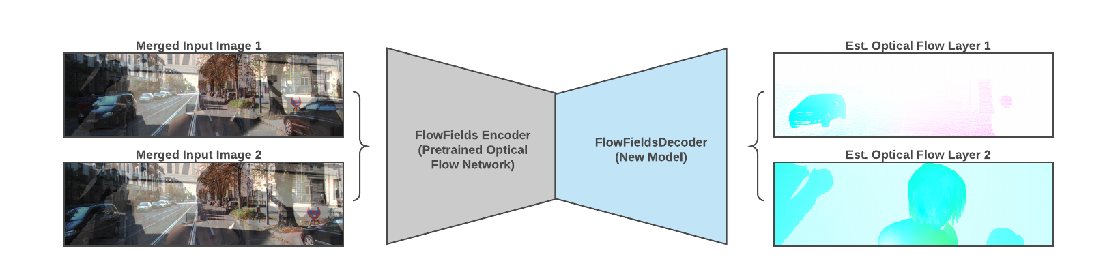
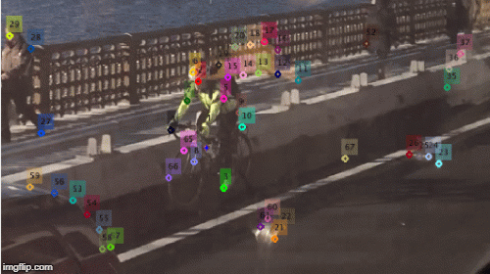
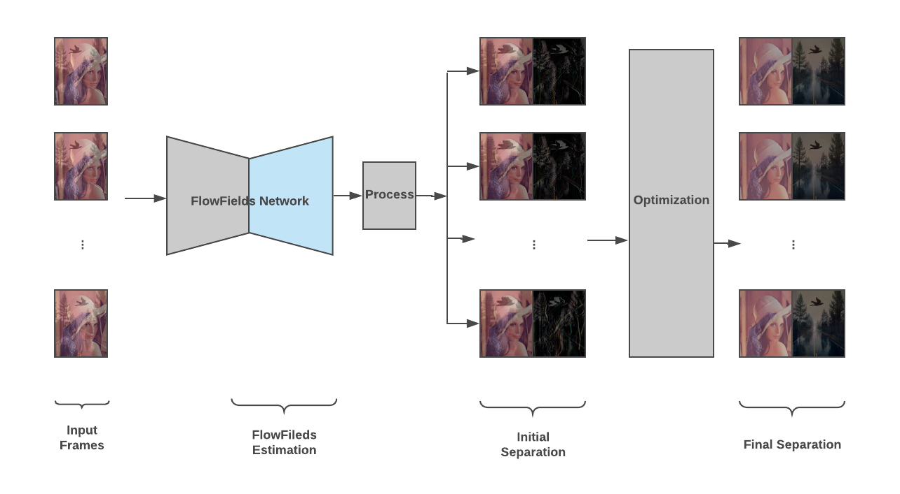
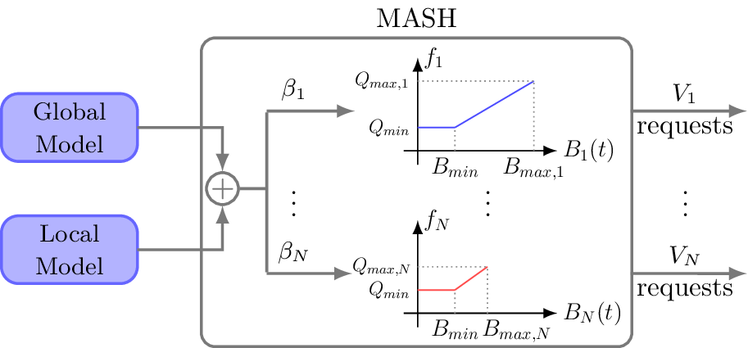
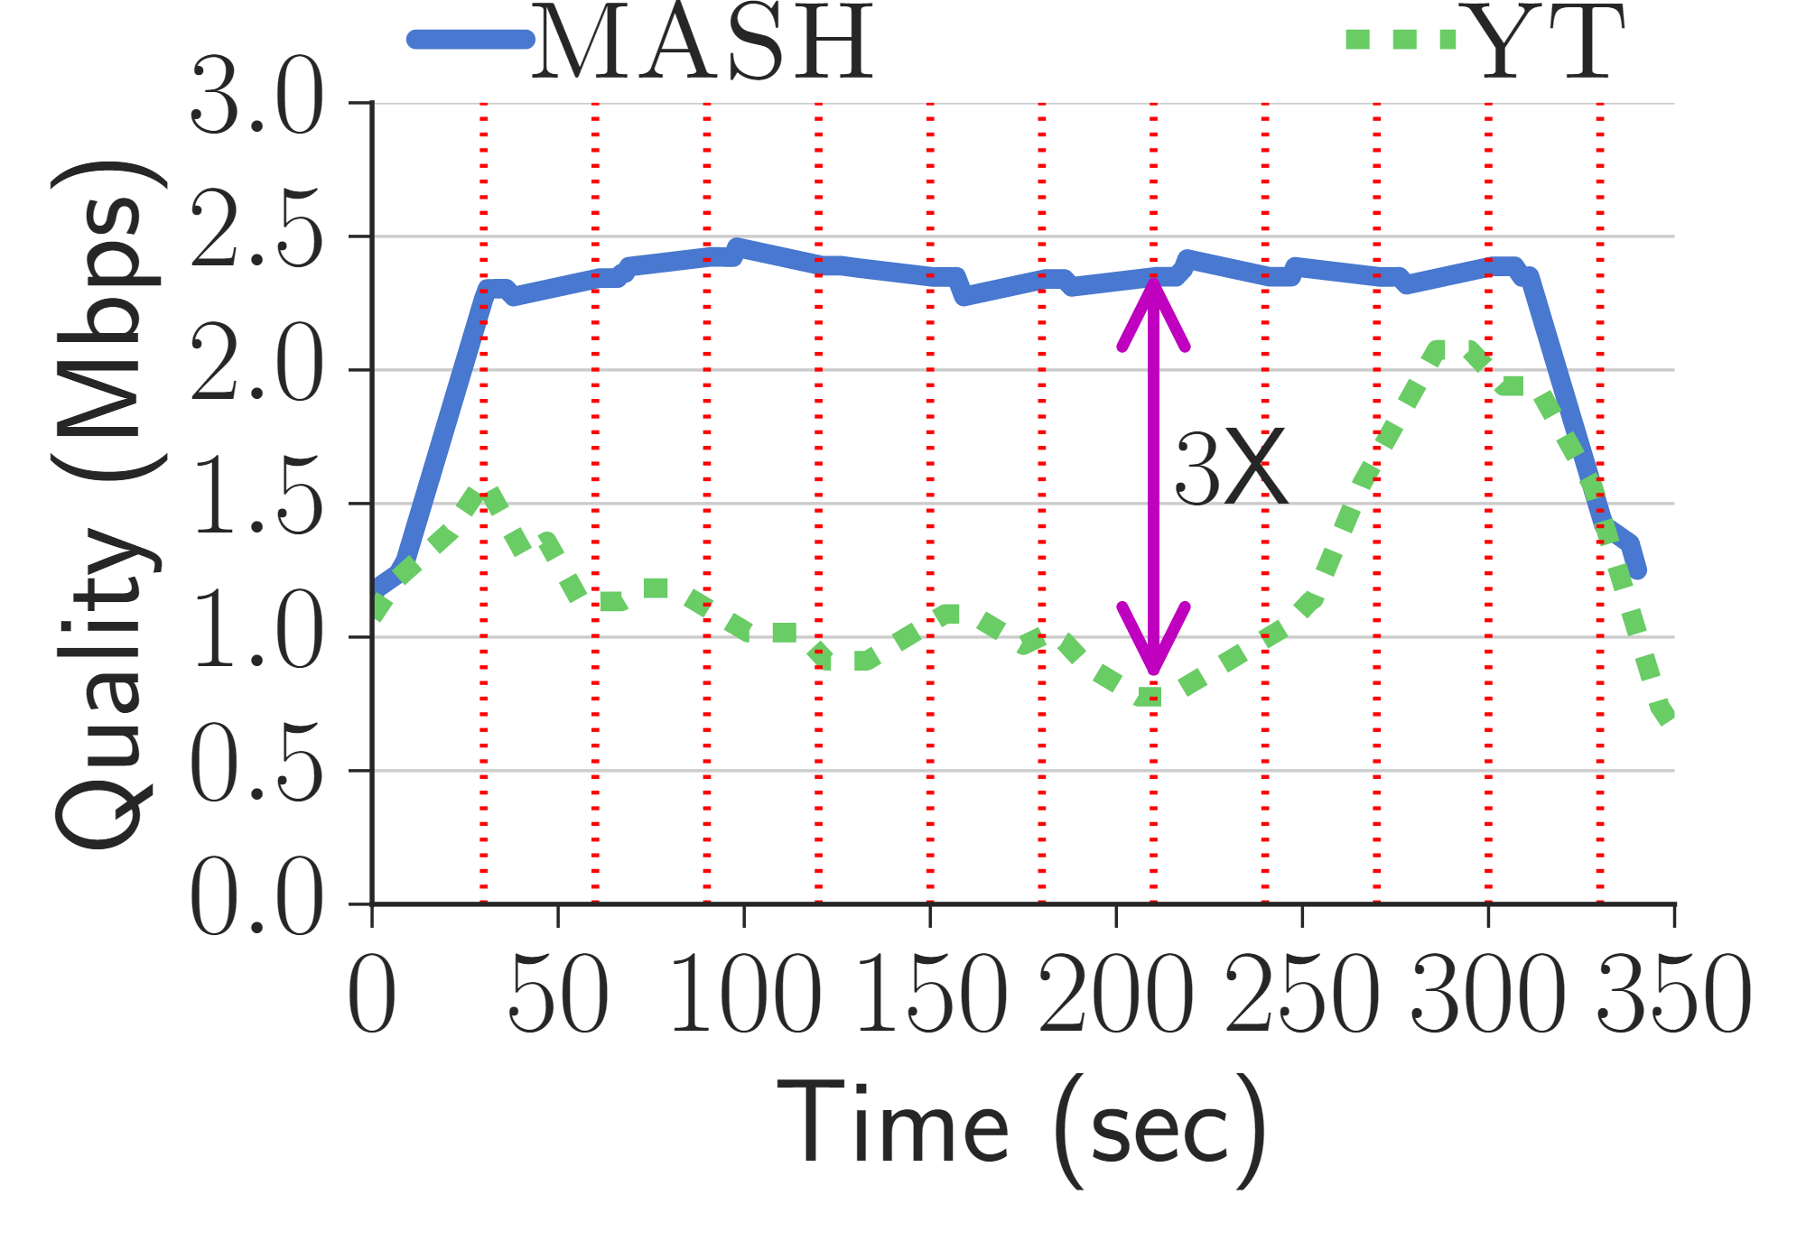

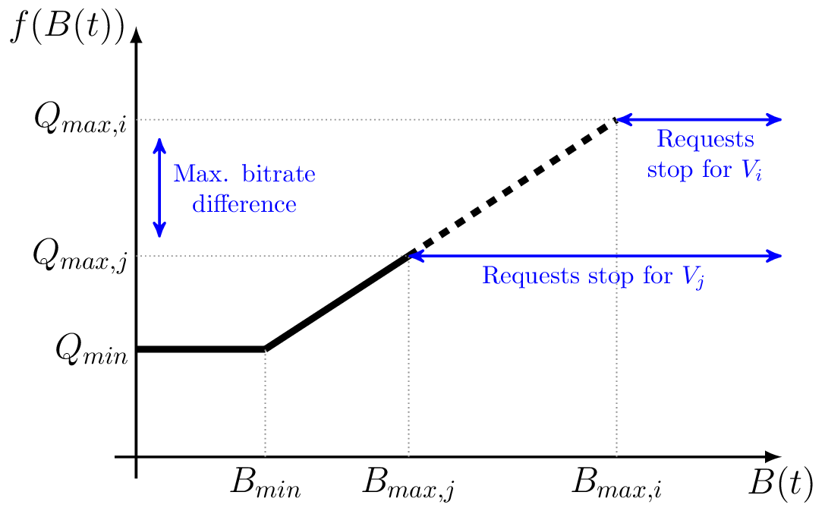

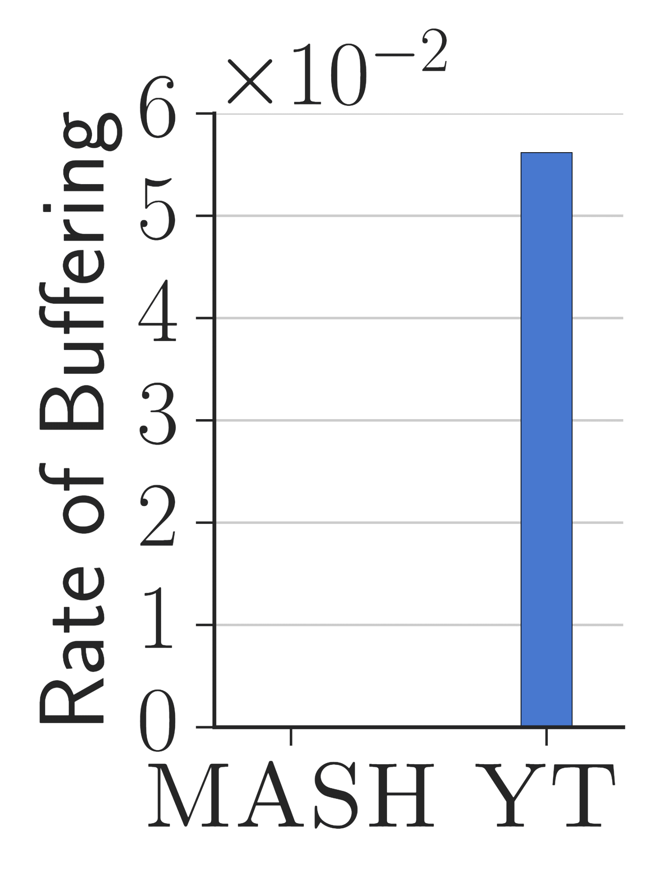
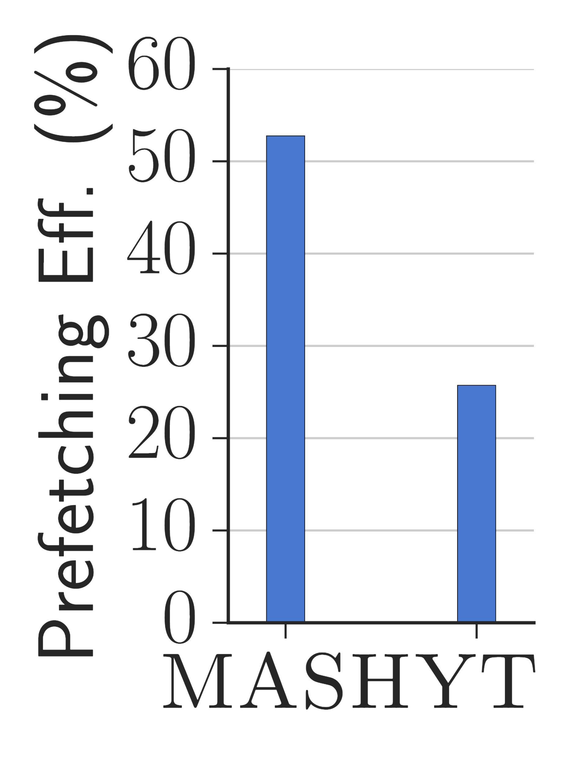


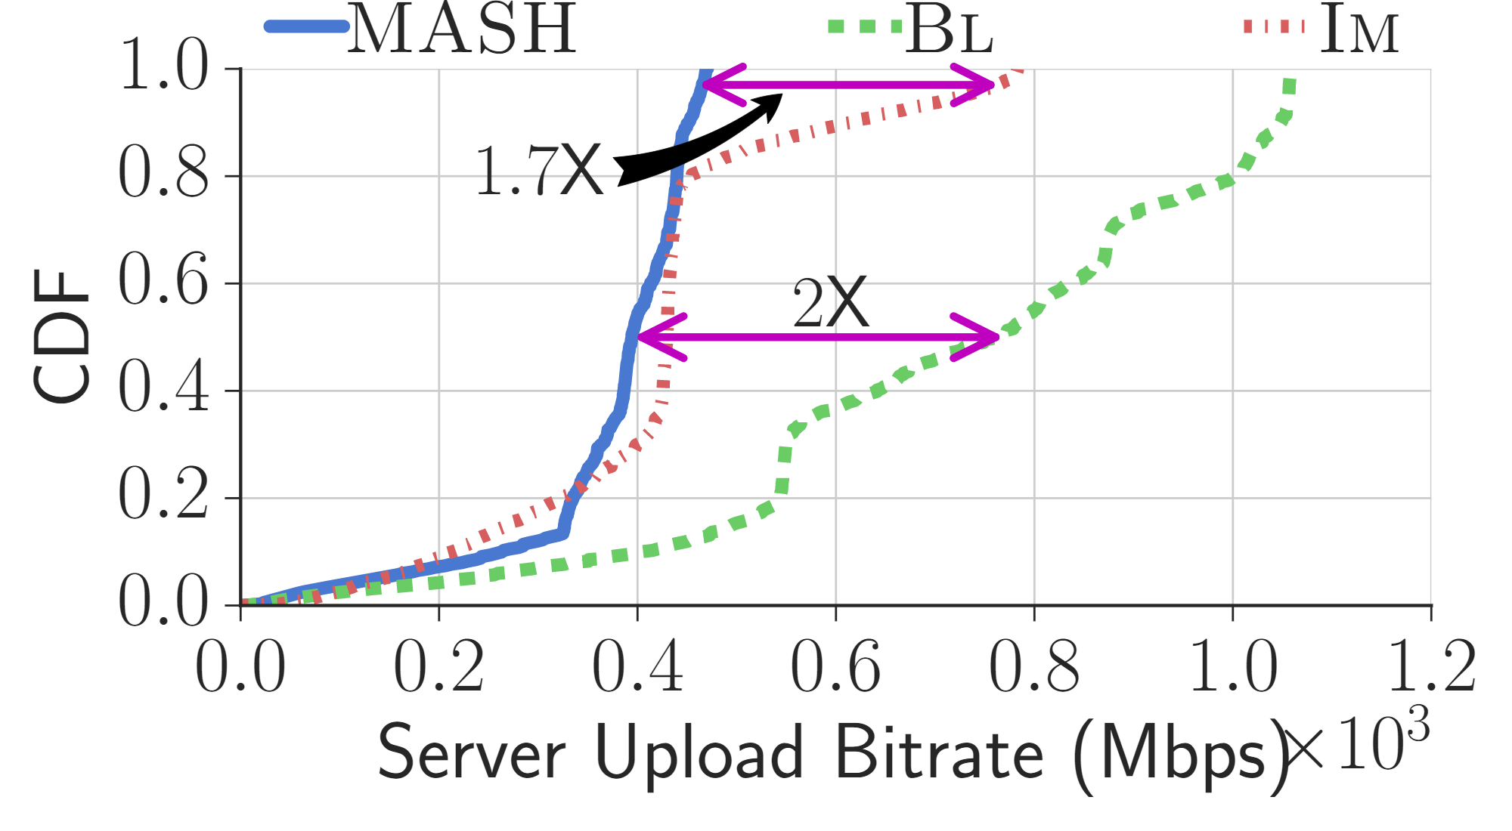
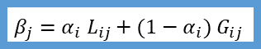
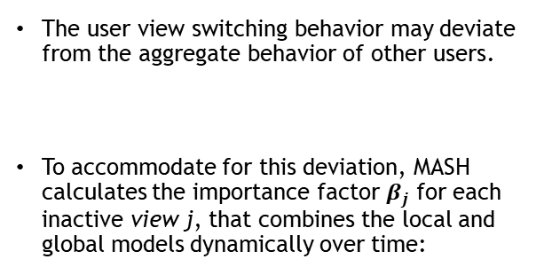

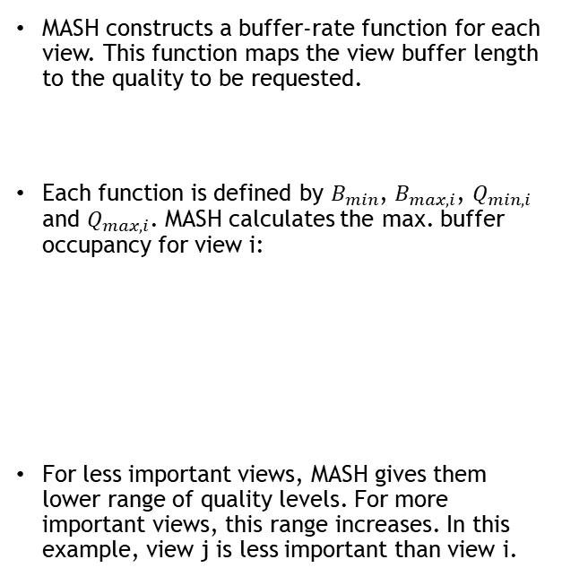
Video Reflection Removal
Amgad Ahmed, Suhong Kim & Mohamed Hefeeda
NSL Lab, SFU
Problem:
Videos are often taken behind a reflective surface causing undesired reflections to exist. We design an algorithm to separate reflection from the background.
Applications:
Photography
Self-driving cars
Pre-processing of CV tasks
Our Approach:
Utilize motion information in the video:
(i) Feature tracking and segmentation
(ii) Background registration
(iii) Background initial estimation
(iv) Reflection initial estimation
(v) Optimization
Problems of Filters:
Traffic overheads
Forwarding loops
Results:
Limitations: Since our approach relies on motion segmentation at the initial stage, it might fails if we got incorrectly clustered feature points in some cases.
Input Background Reflection
Solution 1: User Assistance
Designing a user friendly GUI for annotating and tracking weak features.
Week feature points -> Get more features from a user
Non-planar motion -> Refine clustering by a user
Solution 2: Enhanced Flow-Fields
We can estimate motion field estimation with deep neural network, and then plug it into our pipeline.
(a) Deep Neural Networks estimating two-layered flow fields
User Annotated Feature Points
(b) Modified pipeline
More information: http://nsl.cs.sfu.ca
INTRODUCTION
MASH
3) Building Multiview Buffer-rate Functions:
RESULTS
Multiview videos offer unprecedented experience by allowing users to explore scenes from different angles and perspectives. The user watches an active view, and can switch to any inactive view any time.
In HTTP adaptive streaming, each video is encoded into multiple bitrates, divided into segments, and stored at the server side.
MASH constructs a buffer-rate function for each view. This function maps the view buffer length to the quality to be requested.
Each function is defined by $B_{min}$, $B_{max,i}$, $Q_{min,i}$ and $Q_{max,i}$. MASH calculates the max. buffer occupancy for view i:
For less important views, MASH gives them lower range of quality levels. For more important views, this range increases. In this example, view j is less important than view i.
Against YouTube: On average, MASH produces the same quality without rebuffering, while being 60% more efficient.
MASH vs YouTube - Snapshot
The higher the better
$$B_{max,i}=β_{i}×B_{max}$$
MASH consists of three main steps:
1) Building View Switching Models:
Each model is a Markov chain with states correspond to views, and edges correspond to view switches.
Global Model (G): aggregates the behavior of all users who watched the Multiview video. MASH downloads the global model at the beginning of the session.
Local Model (L): represents user behavior during this session. MASH updates the local model at each view switch. At the end of the session, MASH sends this model to the server.
MASH keeps a counting matrix (M) for the local model. At each view switch from active view i to inactive view j, MASH increments M_{ij}.
V₁
V₃
V₂
The lower the better
The higher the better
In regular 2D videos, a rate adaptation algorithm chooses segment quality based on the dynamic network conditions.
Multiview streaming poses different challenges due to network conditions and user activity:
EVALUATION
We developed a full Multiview client and implemented MASH in it using Java.
We compared MASH against (1) the YouTube Multiview player in single sessions, and (2) variations of 2D rate adaptation algorithms in 100 concurrent sessions. We used a concert video from YouTube.
We used three view switching behaviors and multiple network conditions. Our client does not know users behaviors, however, MASH learns the user behavior during the sessions.
For single sessions, we watched the YouTube Multiview video from our lab. For concurrent sessions, we deployed the sessions to AWS. In both cases, the network conditions were controlled by tc.
Against 2D Variations: MASH reduces server load up to 2X. It is at least 30% more efficient in terms of prefetching. It improves quality up to 50%.
100 Concurrent Clients
1) High Quality of Experience (QoE)
2) Combining Local and Global Models over Time:
The lower the better
2) Prefetching efficiency
The user view switching behavior may deviate from the aggregate behavior of other users.
To accommodate for this deviation, MASH calculates the importance factor $β_{j}$ for each inactive view j, that combines the local and global models dynamically over time:
3) Network load at server side
MASH [1] is a client-based rate adaptation algorithm for Multiview streaming that we designed to solve these challenges.
MASH understands user behavior over time, and chooses quality based on the view buffer length.
$$β_{j}=α_{i} L_{ij}+{(1−α}_{i}){ G}_{ij}$$
REFERENCES
$α_{i}$ is the root mean squared error between $L_{i}$ and $G_{i}$.
[1] K. Diab and M. Hefeeda, MASH: A Rate Adaptation Algorithm for Multiview Video Streaming over HTTP, IEEE INFOCOM 2017

